Slide 1


SmartHire AI
An Agentic AI Assistant Reimagining the Recruitment Lifecycle
RAG SOURCED TOOL CALLING HUMAN-IN-THE-LOOP

Slide 2
The Recruitment Problem
Why modern recruiting is bogged down in manual, administrative fatigue

Slide 3



Recruitment Bottlenecks Today
The Administrative Burden
Passive Legacy ATS
Recruiters expend over 60% of their bandwidth on transactional and manual tasks: sifting through hundreds of repetitive resumes, tailoring outreach messages, rewriting job descriptions, and scheduling calls.
Traditional Applicant Tracking Systems (ATS) act merely as passive data vaults. They require manual triggering, lack natural language semantics, and fail to provide intelligent insights, trends, or salary data contextually.

Slide 4
The Solution: SmartHire AI
A conversational, multi-agent assistant designed to handle autonomous recruiting workflows

Slide 5







Core Capability Pillars
Intelligent Sourcing
Agentic Orchestration
Human-in-the-Loop
Retrieves high-context, indexed candidate profile details semantically from local vector stores using advanced RAG pipelines.
Uses intelligent routing, multi-agent pipelines, and context-aware logic to autonomously perform complex multi-step recruitment flows.
Ensures robust security and control by requiring explicit recruiter confirmation prior to execution of high-risk business triggers.

Slide 6



Autonomous Routing Architecture
SmartHire AI functions as a cognitive orchestrator, analyzing incoming recruiter prompts and routing them to the optimal resource:
RAG / Vector Databases
Invoked for semantic, query-based candidate screening and deep profile extraction.
Deterministic Computations
Calculates metrics, score cards, and matching values locally without prone-to-hallucination LLM logic.
Live Web Queries
Performs real-time search engine sweeps to fetch current salary ranges and competitor trends.

Slide 7
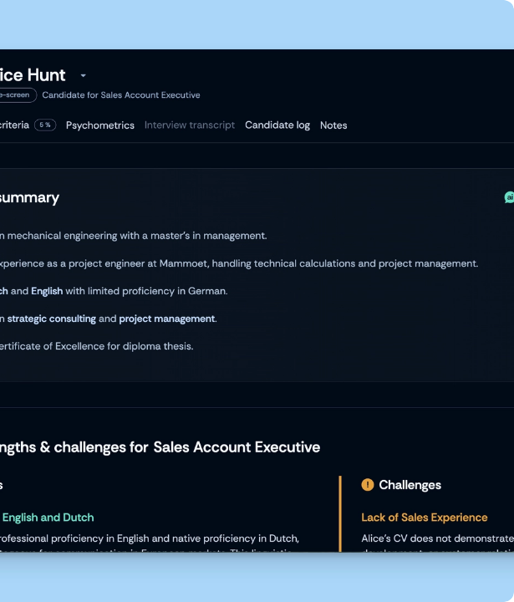
Semantic Resume Screening
Going Beyond Keyword Searching
Traditional parsers fail when CV keywords don't match. SmartHire AI translates entire applicant files into vector embeddings, matching skills contextually.
Using a dense vector search model, the engine ranks candidates based on experience depth, technical capabilities, and hidden potential, drastically reducing evaluation bias.

Slide 8
End-to-End Agentic Workflow
Semantic Screening
Live Benchmarking
Generate Questions
Recruiter Approval
Retrieves matches from CV database using Vector search.
Performs live web queries for competitive salary metrics.
Drafts high-quality technical interviewing rubrics.
Human reviews draft and authorizes candidate contact.

Slide 9
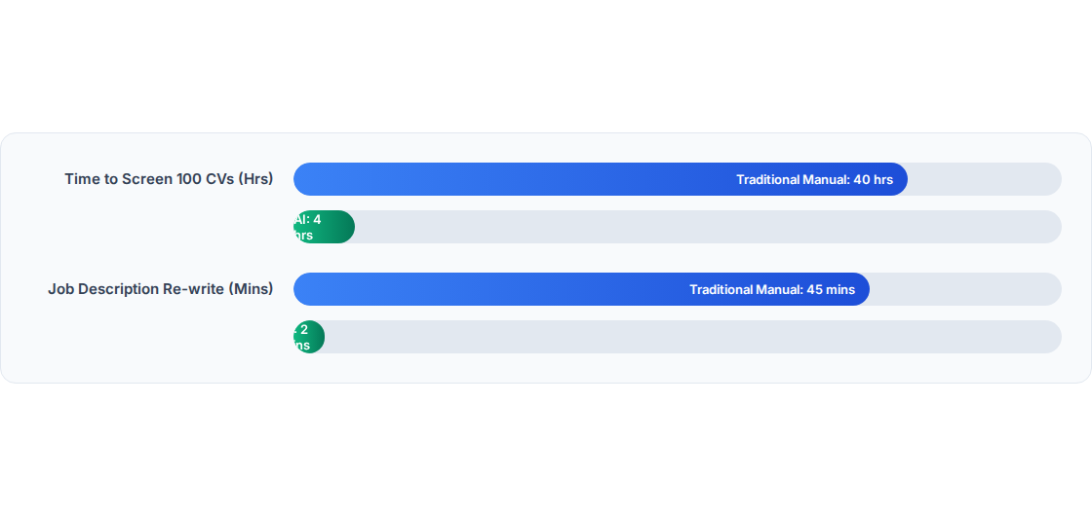
Efficiency Gains: Slashed Hours

Slide 10
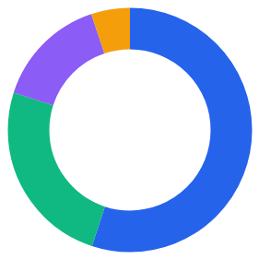
Recruiter Allocation Reimagined
Relationship & Placement Strategy
55%
Interviews & Selection
25%
Collaborative Strategy Meetings
15%
Admin/Data Tracking
5%

Slide 11

Semantic RAG Similarity Model
The matching accuracy between a candidate profile vector and the JD vector is determined by Cosine Similarity:
Trigger Scenario | Core Agent Routing | Executed Tool | Status
Compare python resumes to job brief | Semantic Context Match | RAG DB Tool | Auto
Lookup local DevOps salary ranges | Real-time Web Sourcing | Web Search Engine | Auto
Send interview invites & offer drafts | High-Stakes Dispatch | Email Gateway | HITL Confirmed

Slide 12
THANK YOU !!

